Slide 1

Atharva college of engineering , Malad.
SMART SOCKET
Team member :-
Sharang ambadkar.
Jemin Patel.
Sambhav thole.
Guided by :-
Prof. Smita Patil.

Slide 2
INDEX
ABSTRACT
INTRODUCTION
OBJECTIVES
SCOPE OF PROJECT
HARDWARE & SOFTWARE
BLOCK DIAGRAM
MECHANISM
CONCLUSION
REFERENCES

Slide 3
ABSTRACT.
In our day to day life we unknowingly tend to waste a lot of electric power due to unintentionally forgetting to switch off the button after use, due to which a lot of electricity is wasted.
Sometimes we tend to keep our laptop or phone for charging and forget to switch off the button and the device charges over
a long period of time or sometimes even overnight. This tends the Device to over heat and causes damage. We have come across many incidents were the phone was blasted due to overheating.
To overcome this we are building prototype of a smart socket.

Slide 4
INTRODUCTION.
We chose this project topic because everyday a lot of electricity is being wasted as at times people leave their devices with the switches turned on and forget about it, resulting in waste of electricity. With our project the smart socket , electricity and money can be saved.

Slide 5
OBJECTIVES
•The smart socket can be used to save electricity and money.
•The user will be able to choose a specific time constraint for the smart socket to work.
•The Time can be set by the user on an app along with a manual way to turn the socket on or off as wanted.

Slide 6
LITERATURE SURVEY
1. Identifying hot socket problem in smart meters
Zhen Bao ; Zuyi Li
2016 IEEE Power and Energy Society General Meeting (PESGM)
Year: 2016
2.Design and Implementation of Socket Based-Network Connections Smart Home System
Min Xiao ; Yu-Han Liu ; Qian Hu
2016 Sixth International Conference on Instrumentation & Measurement, Computer, Communication and Control (IMCCC)
Year: 2016

Slide 7
SCOPE OF PROJECT.
A smart socket has various uses in home automation as well as commercial sector.
It helps to save electricity by defusing the current supply.
It helps to enhance the life of devices.

Slide 8
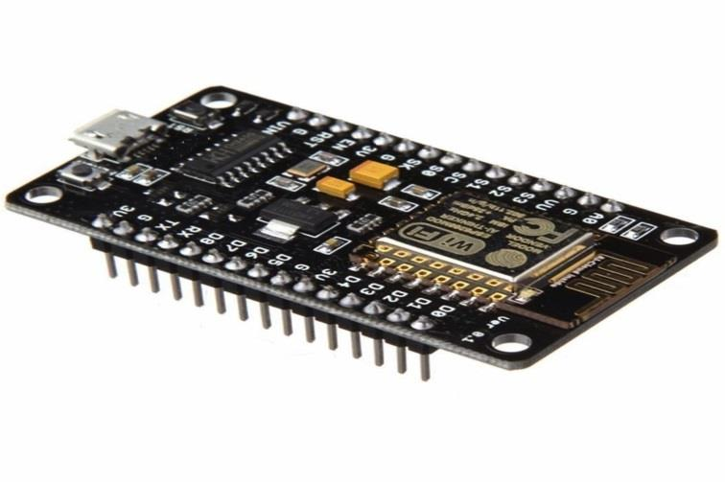
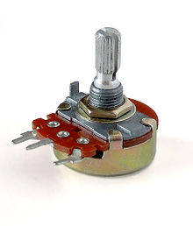
HARDWARE AND SOFTWARE USED.
HARDWARE :-
Node MCU Wi-Fi internet.
Potentiometer.
Resistors 220 V.
Connecting wires.
Bread board.
Software :-
Arduino IDE.
MIP app inventor.
Android studio IDE.

Slide 9
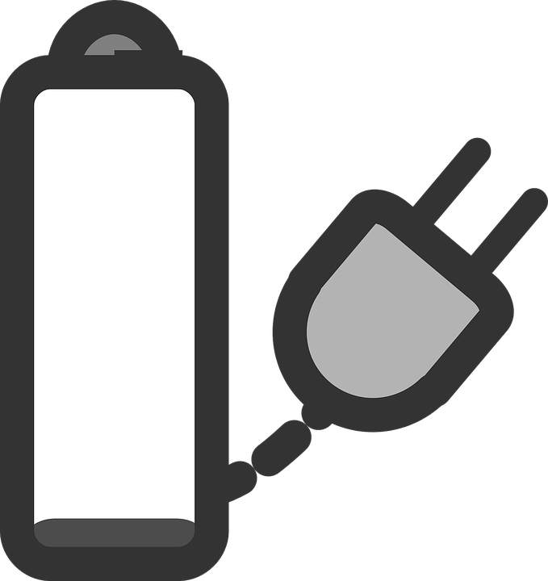
BLOCK DIAGRAM.
Node MCU Wi-Fi internet.
potentiometer
socket

Slide 10
MECHANISM.
Smart socket devices is a which will mainly work on Potentiometer module,
This potentiometer connected to Node MCU is controlled by the app over the same WiFi network
The application has two functionality namely.
•On/off
•Set timer

Slide 11
REFERENCES.
1 .https://www.hackster.io/taifur/smart-plug-b653f2
2.https://engineer2you.blogspot.com/2017/12/make-smart-socket-wifi.html
3.https://developer.android.com/studio/
4. http://remotexy.com/en/examples/smartsocket/
5. https://ieeexplore.ieee.org/document/7741846/
6.https://ieeexplore.ieee.org/document/7774884/

Slide 12
CONCLUSION
This project proposed a smart socket system consisting of a wireless sensor network interfaced with a mobile application. The proposed system allows personal consumers real-time access to energy consumption information. It also facilitate controlling this consumption by allowing the end users to turn on or off loads connected to the smart plug system. The paper also studies the perceived usefulness and satisfaction with the system using an extended information system success model which integrates environmental concerns as a participating key factor. We conclude that environmental concerns impact positively the perceived usefulness and satisfaction with the system.

Slide 13
THANKYOU

